Slide 1

ChatBot : Conversational AI for PDF Manuals/Documents
MajOR ABHISHEK YADAV
2022DA04453

Slide 2
Goal
The development of a locally deployed AI-powered chatbot for the Army will significantly enhance the efficiency and accuracy of accessing information from a large repository of digital documents.
Key features-
It needs to provide precise and contextually relevant answers.
The chatbot should support accurate and all encompassing info retrieval.
It should make available the latest information ensuring confidentiality level, pertaining to the document and hierarchy within the Indian Army.

Slide 3
Objectives
Local LLM Deployment Model Selection:
Download and deploy suitable models locally like openchat, tinyllama etc.
Local Endpoint Creation: Secure data processing using LM Studio.
Custom Reranking Metadata Management:
Tag documents with metadata, including dates and categories.
Embedding and Storage: Store embedded documents with metadata in a vector database.
Ranking Algorithm: Prioritize newer documents for the most current information.
Role-Based Access Control (RBAC)Defining Sensitivity Levels:
Categorize documents into four sensitivity levels for defining access and their categories.
Integrate roles and permissions unique to user through Authorization Matrix to ensure requisite access only.

Slide 4
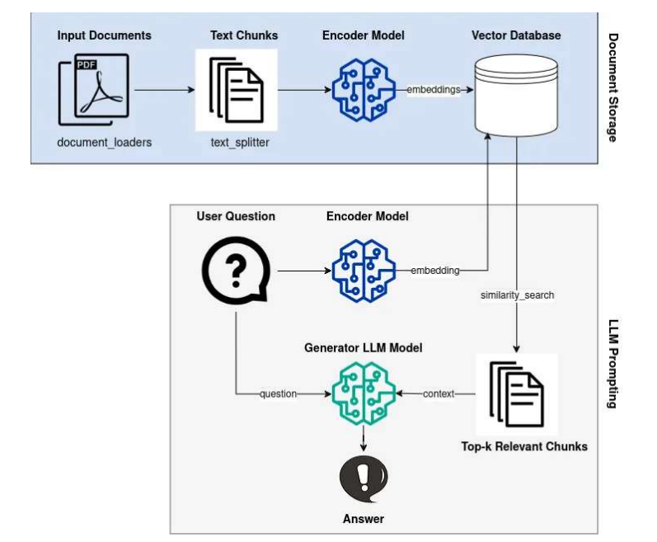



Chatbot Architecture
Function for Filtering Documents
Documents Reranking as per Date
Access based Documents retrieved

Slide 5
Exclusion/Inclusion
Inclusion
Simple UI Interface - Streamlit
Version/Date based document detection
Exploring Custom filtering system –Role based access control
Locally available LLM – LM Studio
Multiple Categories for Metadata of document
Prevent prompt Poisoning.
Exclusion
Fine Tuning LLM
Scanned PDFs

Slide 6
Measurement Criteria
Accuracy of responses.
Document Relevance for Vintage
Document relevance for Department
User satisfaction and feedback.
Response time to queries.
Minimal Hallucination

Slide 7
Completion/Success Criteria
Successful deployment of the chatbot on private WAN.
Quick and accurate info retrieval.
Efficient handling of queries with high accuracy.
Ability to scale for large no of documents.
Secured Access to requisite individuals

Slide 8
Improvements and Risks
A
Data Privacy & security
B
Model Accuracy & Relevance
C
Hallucination
D
Scalabilty

